Slide 1


SENTIMENT ANALYSIS OF TWEETS
By Group 14
Priyanshu Garg (220649), Jatin Singh (220347)

Slide 2
INTRODUCTION
A circular economy is an economic model that aims to minimize waste and make the most of resources. In a traditional linear economy, products are manufactured, used, and then discarded as waste. In contrast, a circular economy seeks to design and implement systems where products are used, recycled, and their materials are looped back into the production cycle, thereby reducing the overall impact on the environment.

Slide 3

ROLE OF SOCIAL MEDIA
Social media enhances circular economy by raising awareness, fostering communities, and influencing sustainable behaviors. It serves as a platform for businesses to showcase circular initiatives, facilitates collaboration, and empowers consumers to make informed, eco-friendly choices. Through real-time updates and policy advocacy, social media accelerates the transition towards a more sustainable and circular economy.

Slide 4
STUDY PURPOSE
This presentation delves into an analysis of tweets related to the circular economy, aiming to uncover the sentiment and engagement patterns within these discussions on Twitter. By examining tweets over a selected period, this study seeks to understand how the circular economy is perceived by the public, identify key themes driving the conversation, and gauge the impact of social media discourse on promoting sustainable practices.

Slide 5
OBJECTIVES
To analyze public sentiment towards the circular economy on Twitter, identifying predominant attitudes and emotions.
To assess engagement levels, examining which aspects of the circular economy generate the most discussion, support, or criticism.
To provide insights into how social media can influence and reflect public interest and policy discourse on sustainability.

Slide 6
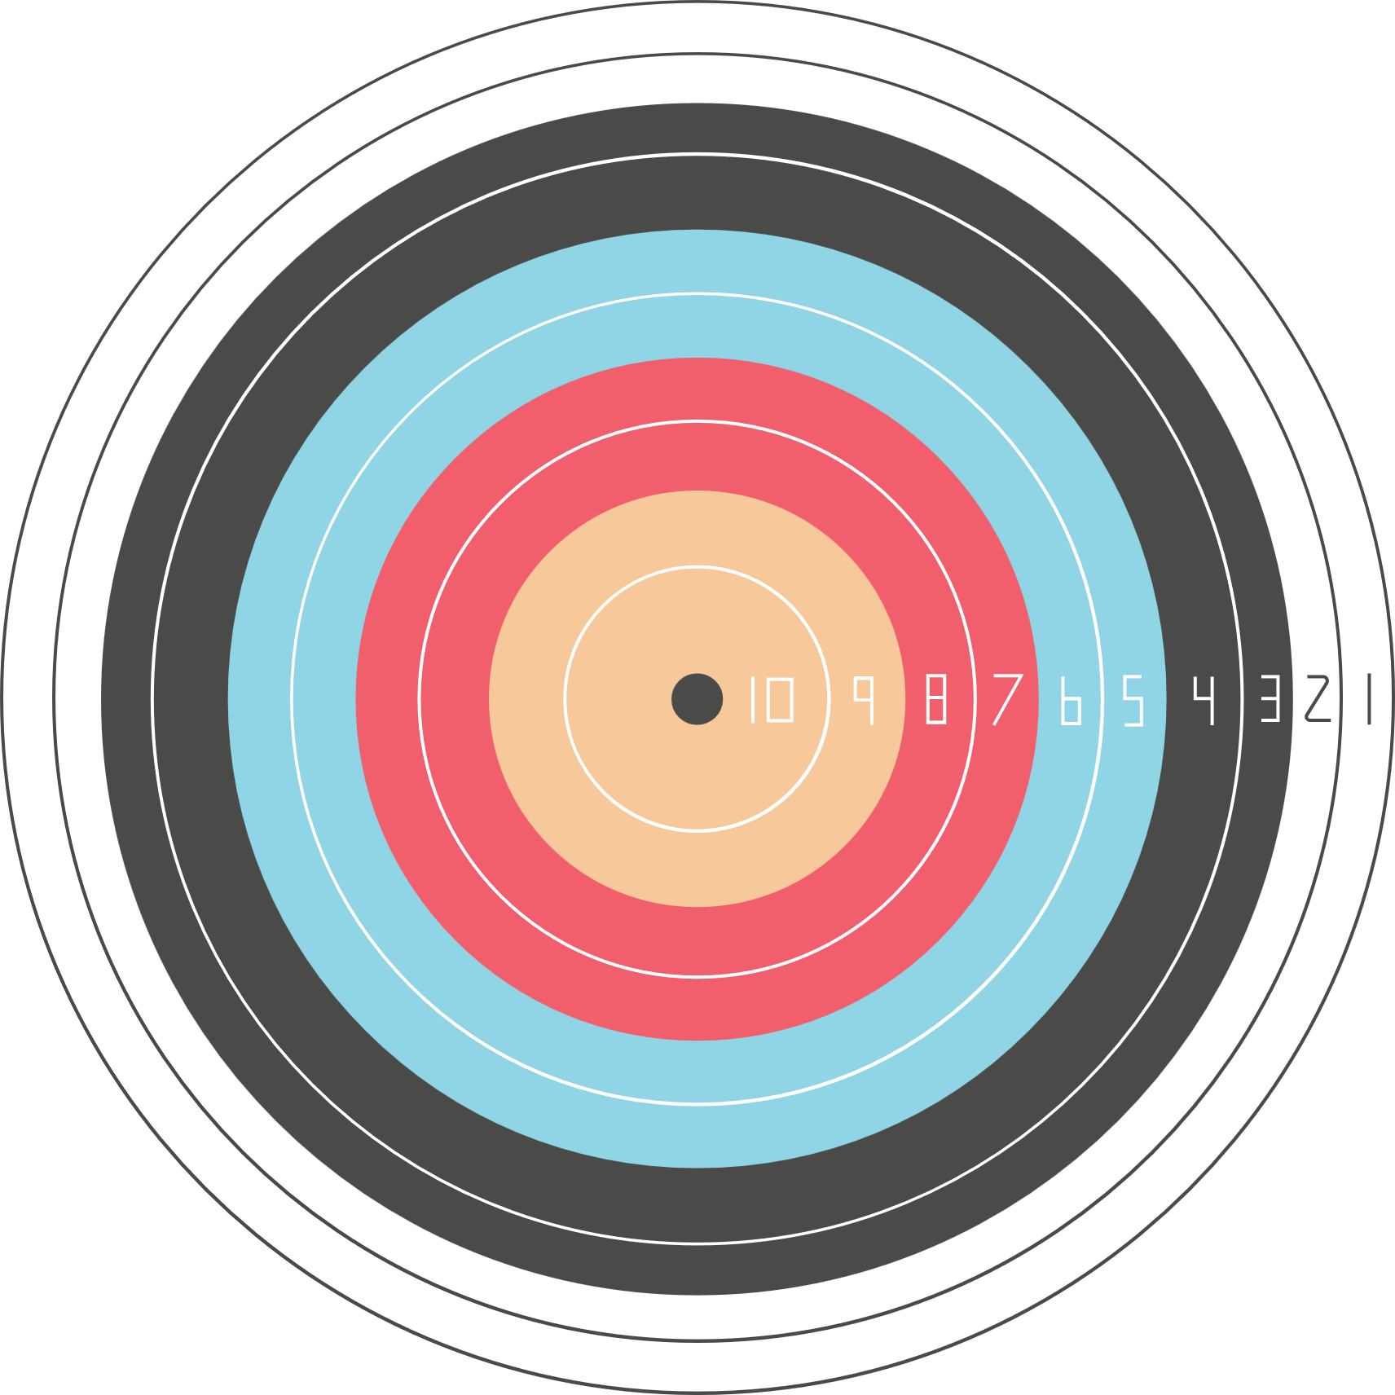

METHODOLOGY

Slide 7

Preprocessing
The collected tweets underwent preprocessing to clean and standardize the data. This process involved removing irrelevant characters (e.g., URLs, emojis), standardizing date formats, and extracting relevant information such as tweet text, timestamp, likes, and retweets for further analysis

Slide 8
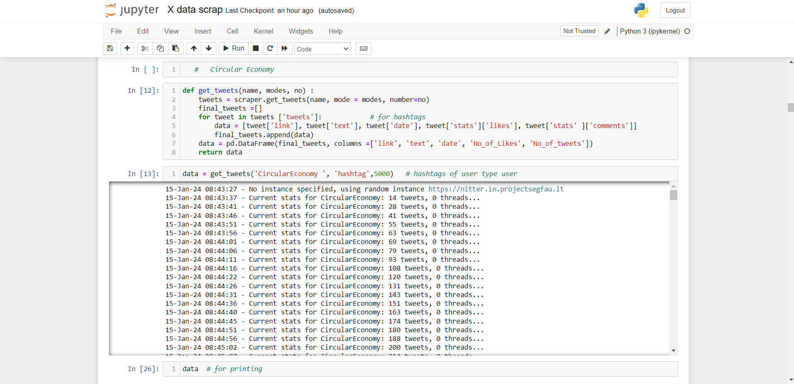

Slide 9
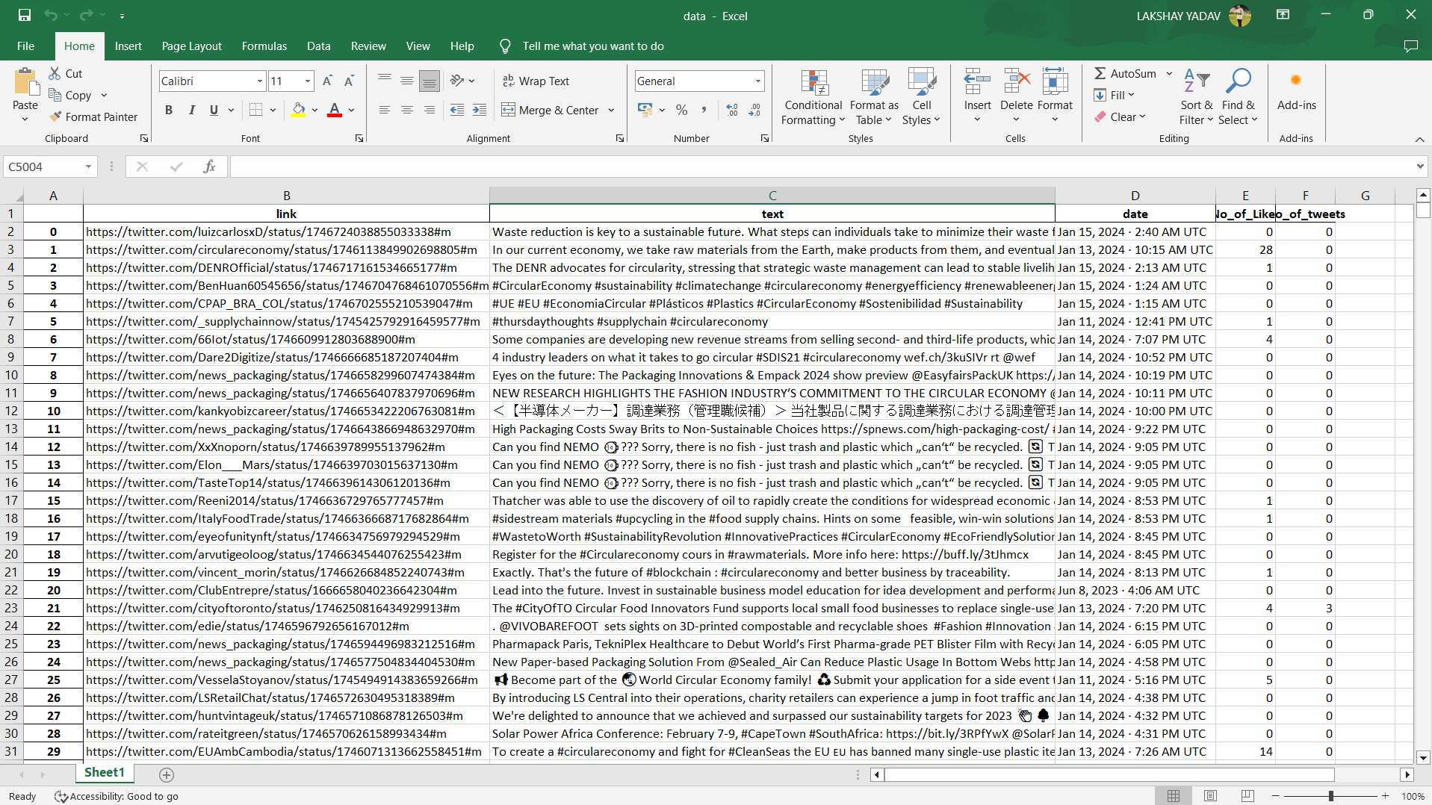

Slide 10

SENTIMENTS AND ANALYTICS
Sentiment Detection: To analyze the sentiment of the collected tweets, we employed natural language processing (NLP) techniques. This involved categorizing tweets into positive, negative, or neutral sentiments based on their content. The sentiment analysis was conducted using pre-trained models or algorithms tailored to understand the nuances of social media language.
Analytical Approach: The sentiment scores provided a quantitative measure of public perception towards the circular economy. By aggregating these scores, we were able to identify overall sentiment trends, fluctuations in public opinion over time, and the impact of specific events or announcements on public sentiment.

Slide 11
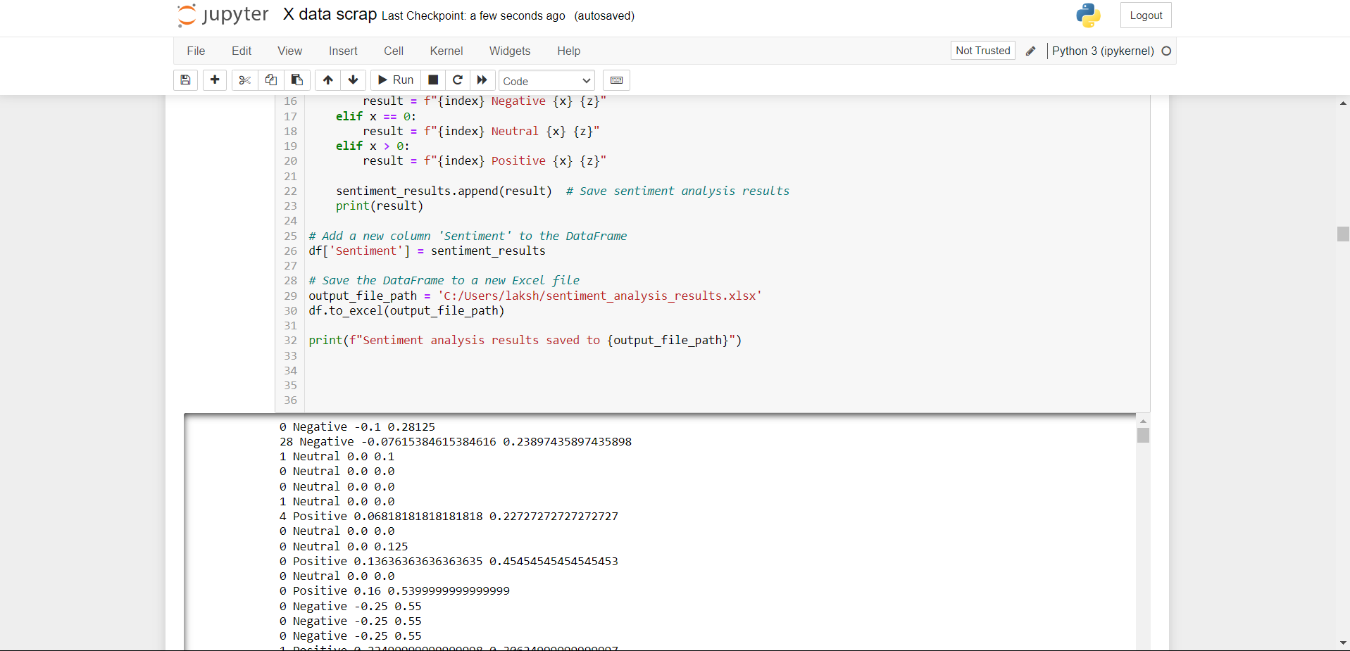

Slide 12
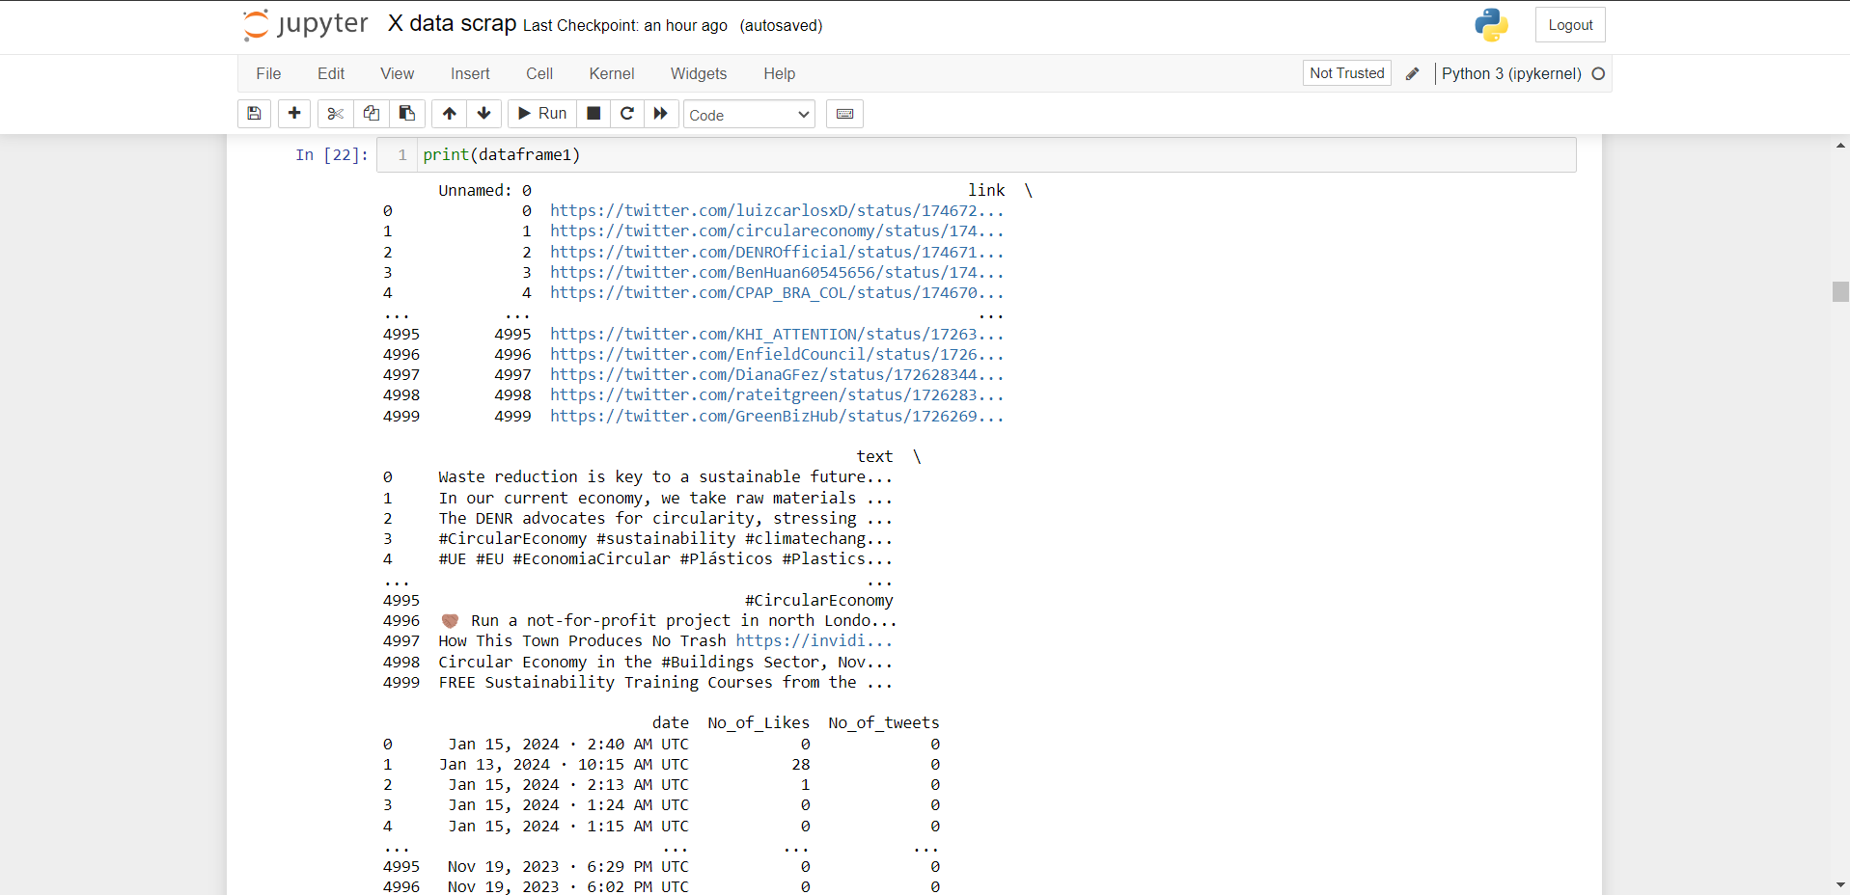

Slide 13
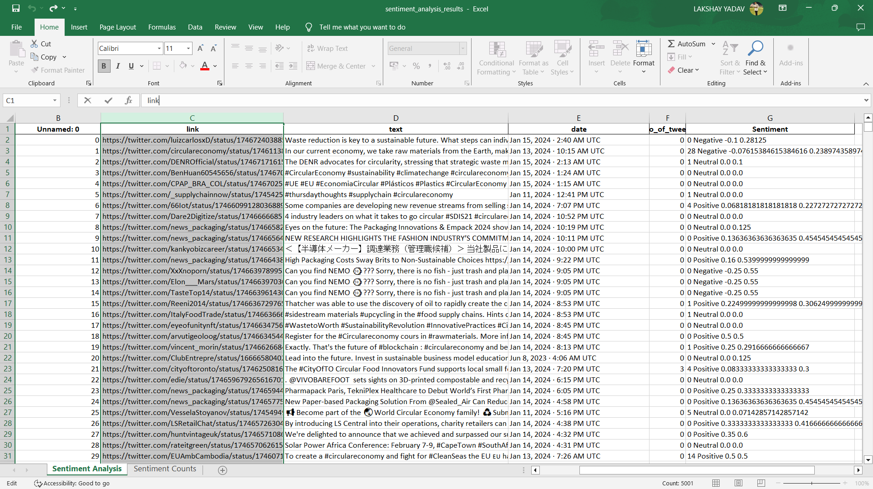

Slide 14

FILTERING
Now all the data that is 5000 tweets divided into fours parts so we can analysis them
These tweets are divided into 4 parts that is -
Zone of Fading out
Zone of Growth
Zone of Excellence
Zone of Viral Trends

Slide 15
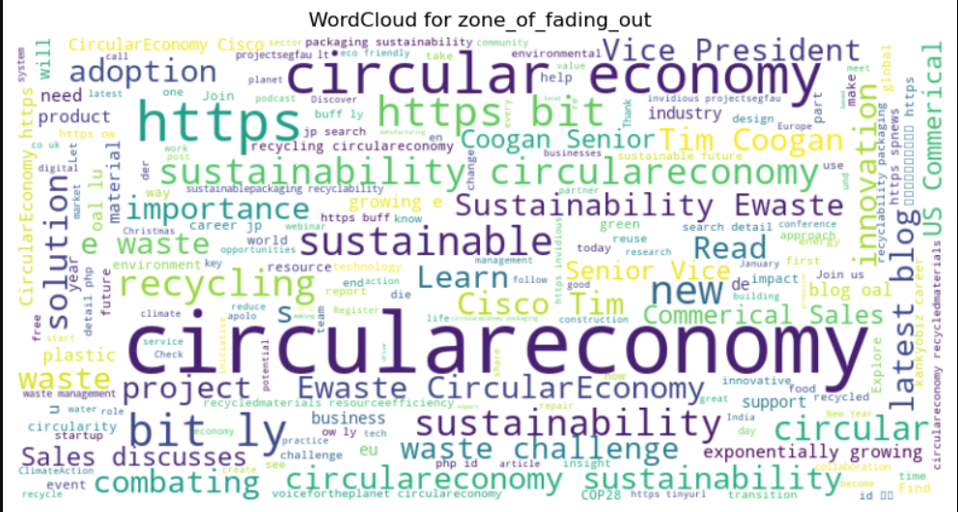

Slide 16
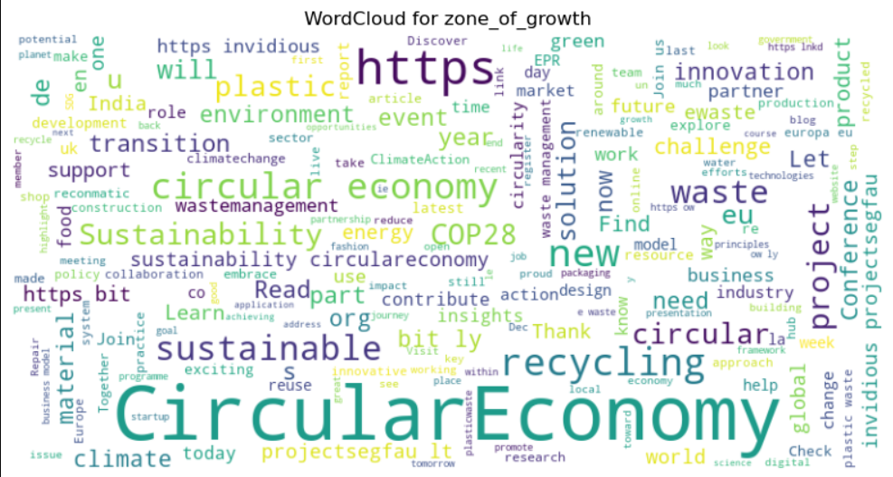

Slide 17
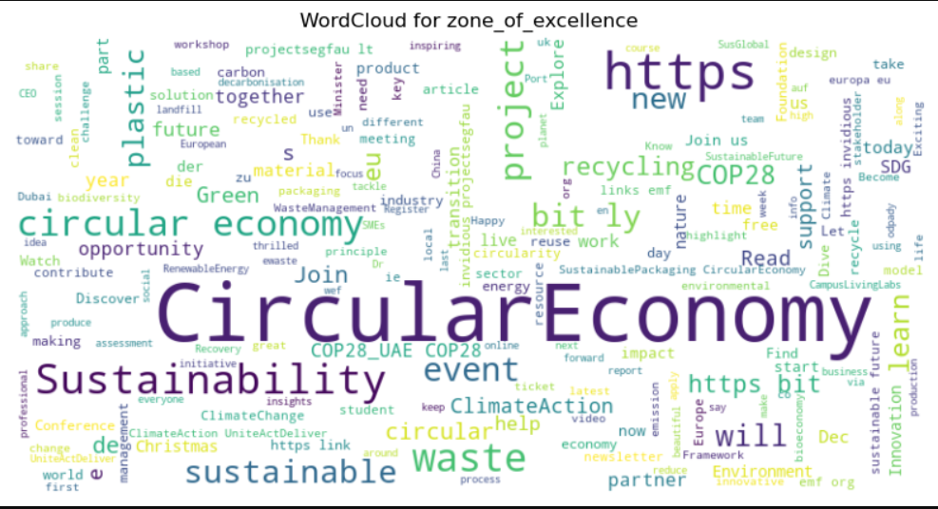

Slide 18
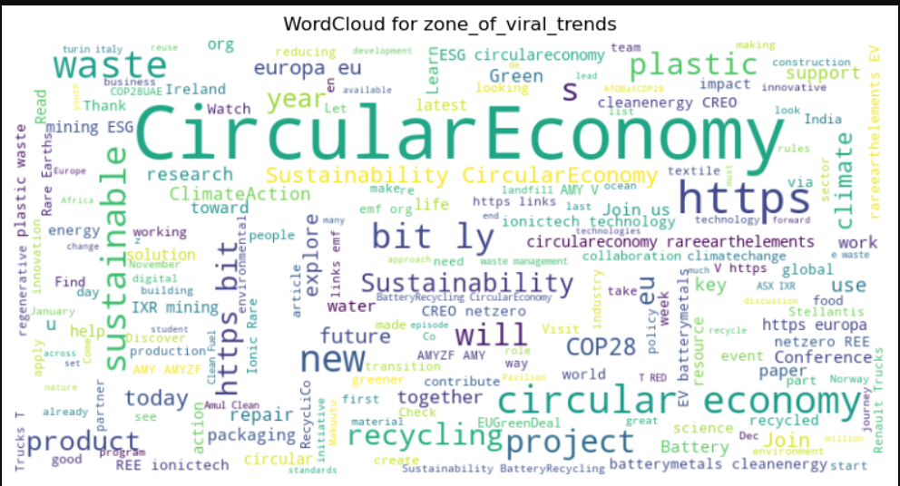
Word Cloud for each group

Slide 19

ANALYZING WITH GRAPHS
After filtering data into 4 parts than we have created their separate word cloud and graph for the comparison which let us know about the which type of tweets or data is in trend and the graph tell us that how many positive and negative reviews or tweets are there in each group

Slide 20
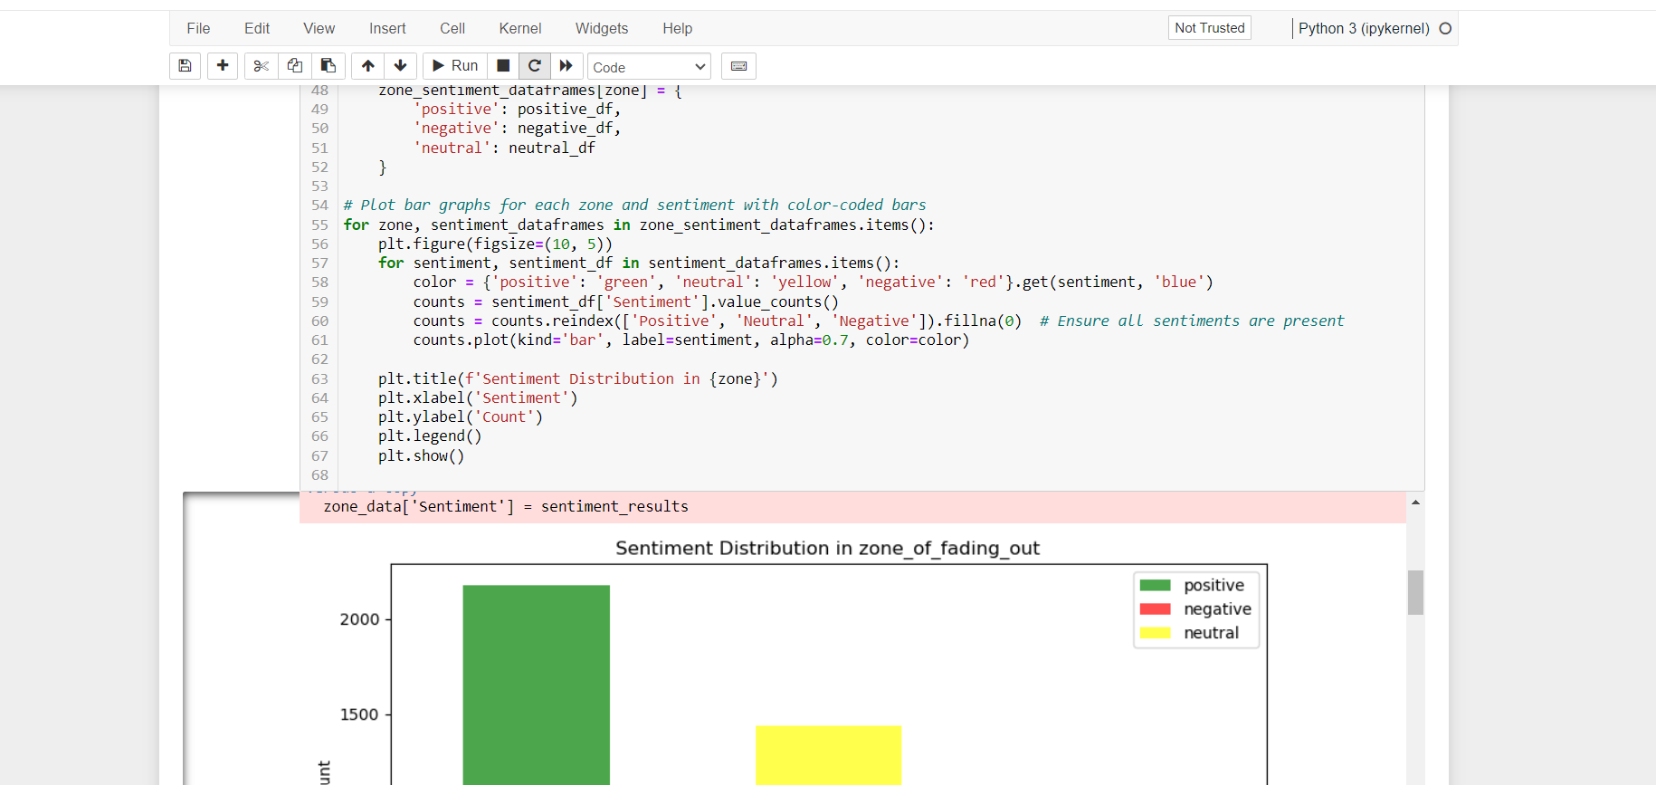
Code for Bar graph

Slide 21
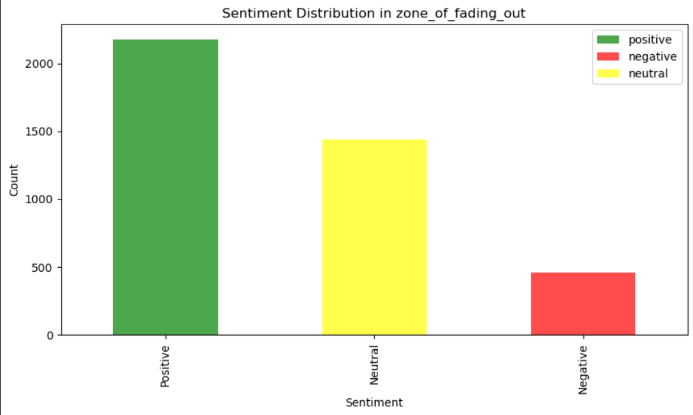

Slide 22
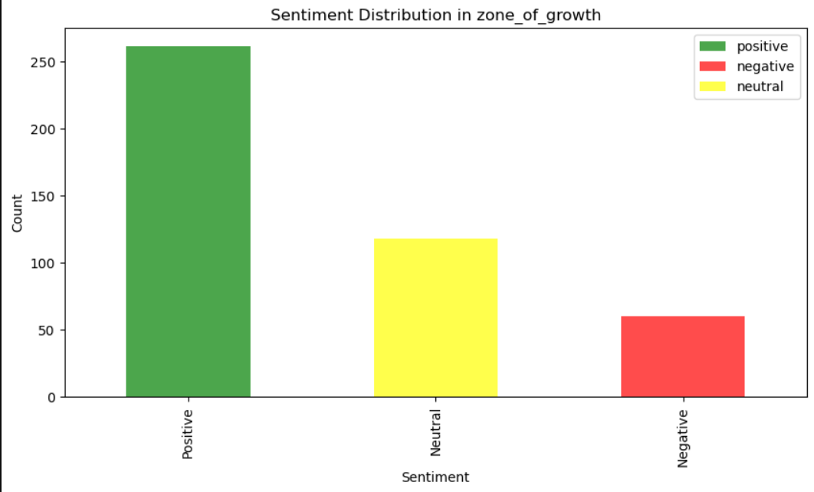

Slide 23
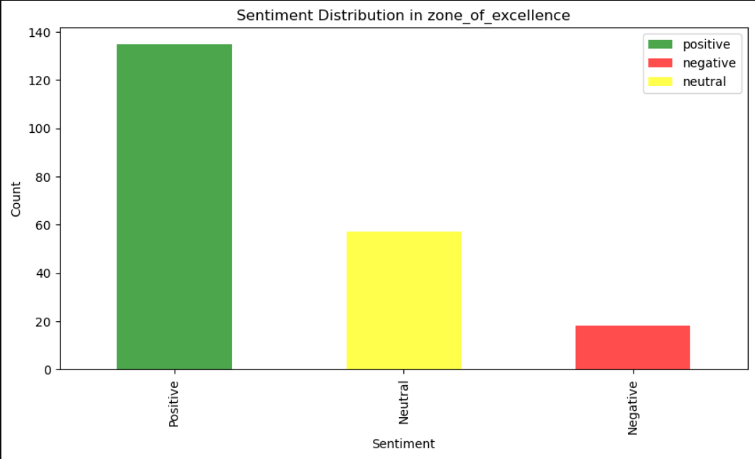

Slide 24
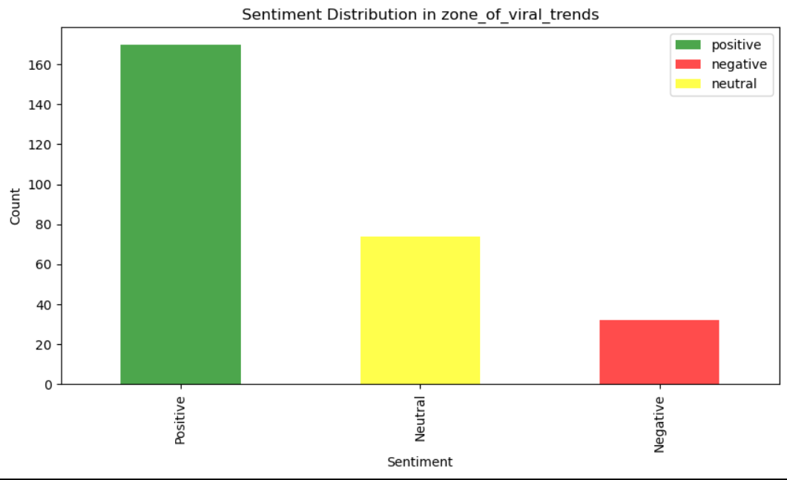

Slide 25

REGRESSION MODEL
We have use regression model in this for
Data processing
Model Training
Model Evaluation
For user input Prediction

Slide 26
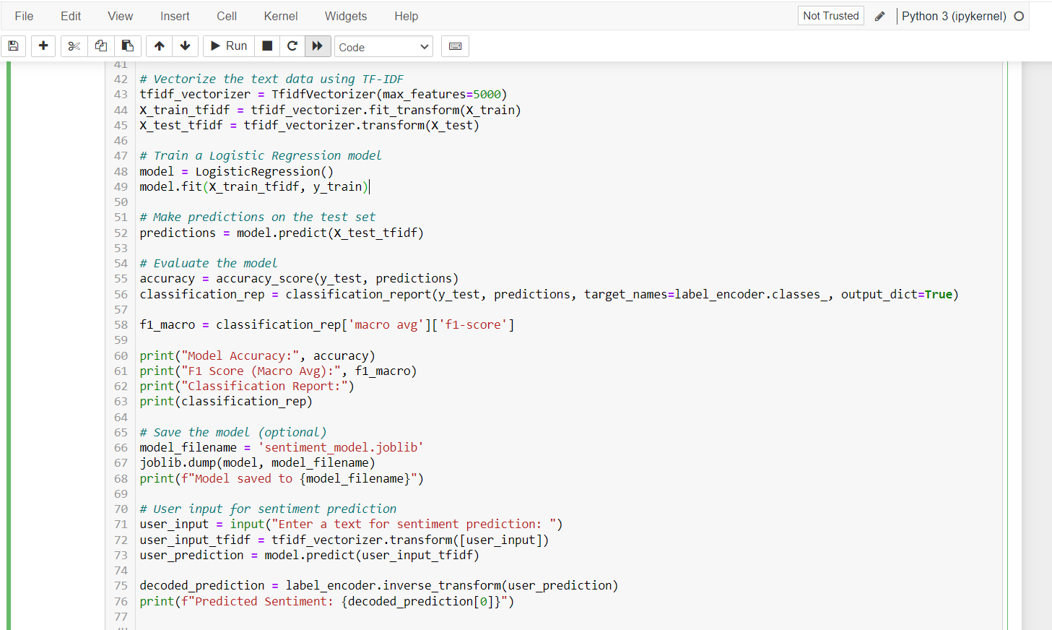

Slide 27
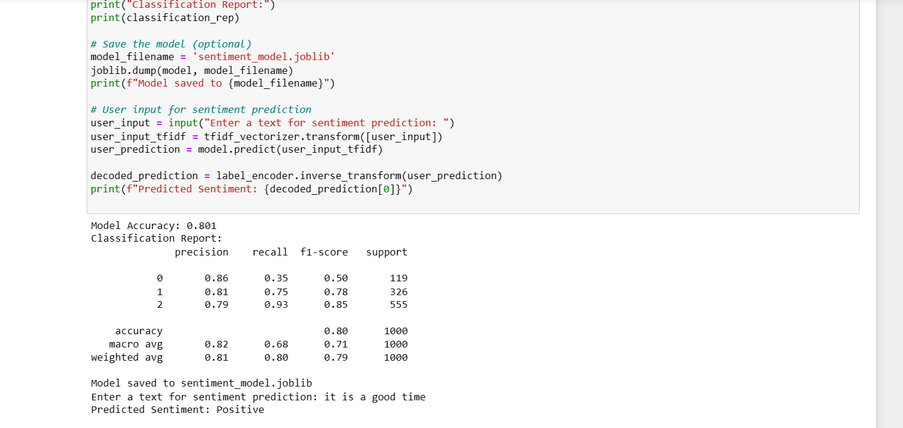

Slide 28
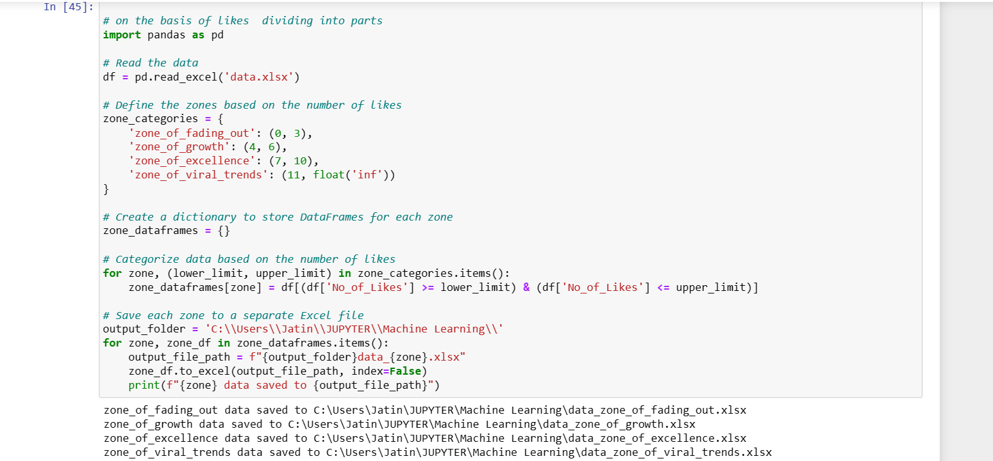

Slide 29
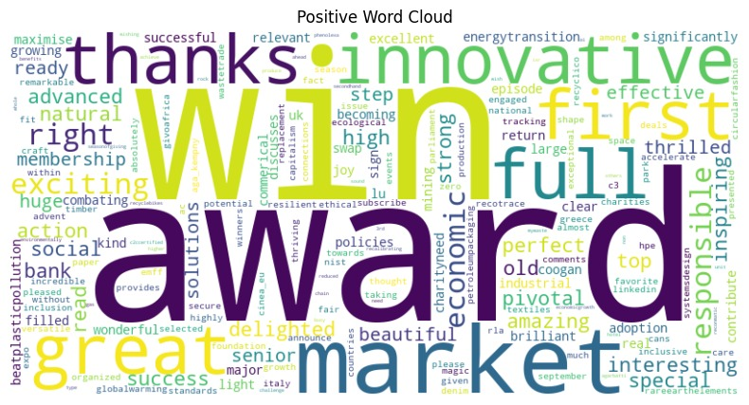
Positive Word Cloud

Slide 30
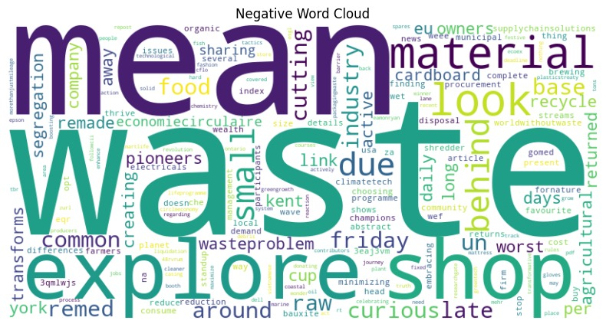
Negative Word Cloud

Slide 31
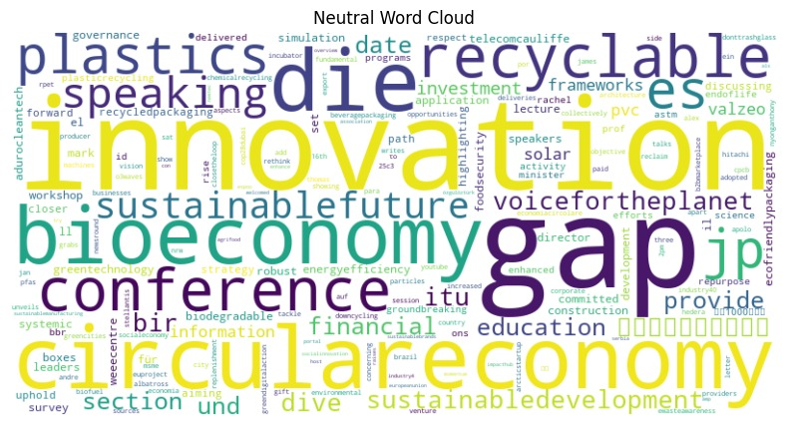
Neutral Word Cloud

Slide 32

WORDS THAT ARE MAKING THEM POSITIVE , NEGATIVE AND NEUTRAL

Slide 33
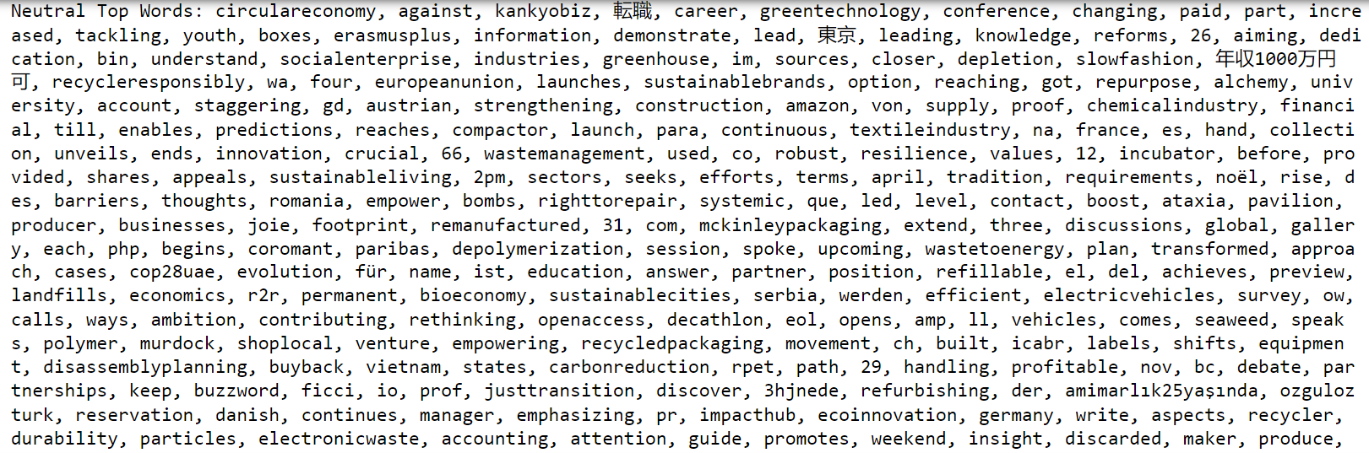

Slide 34
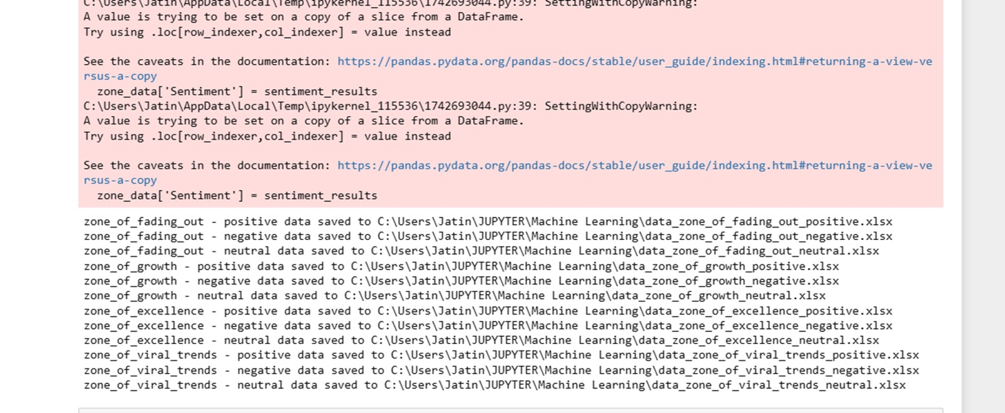
FILTERING OF GROUPS
After scrapping 5000 tweets we have divide them into 4 groups for analysis then to make it more clear then we have divide each group in further parts that is negative , positive and neutral

Slide 35
ARE THERE ANY QUESTIONS?

